Slide 1
Inventory Management System

Slide 2
Manage a database of records.
Operations to be performed:-
Display menu.
Insert new record into (possibly empty) database.
Delete record.
Update records.
Search records.
Problem Statement

Slide 3

Inventory Management
The inventory management system allows users to monitor and control inventory levels, track product movement, and generate bills for customers.
The system is designed to enable users to manage their inventory accurately and effectively, ensuring that they have the right products in stock at the right time.

Slide 4

Technologies
Python(Numpy, Matplotlib, Tkinter, etc.)
Sqlite3, MySQL Workbench.
Tableau.
This Photo by Unknown author is licensed under CC BY-SA.

Slide 5
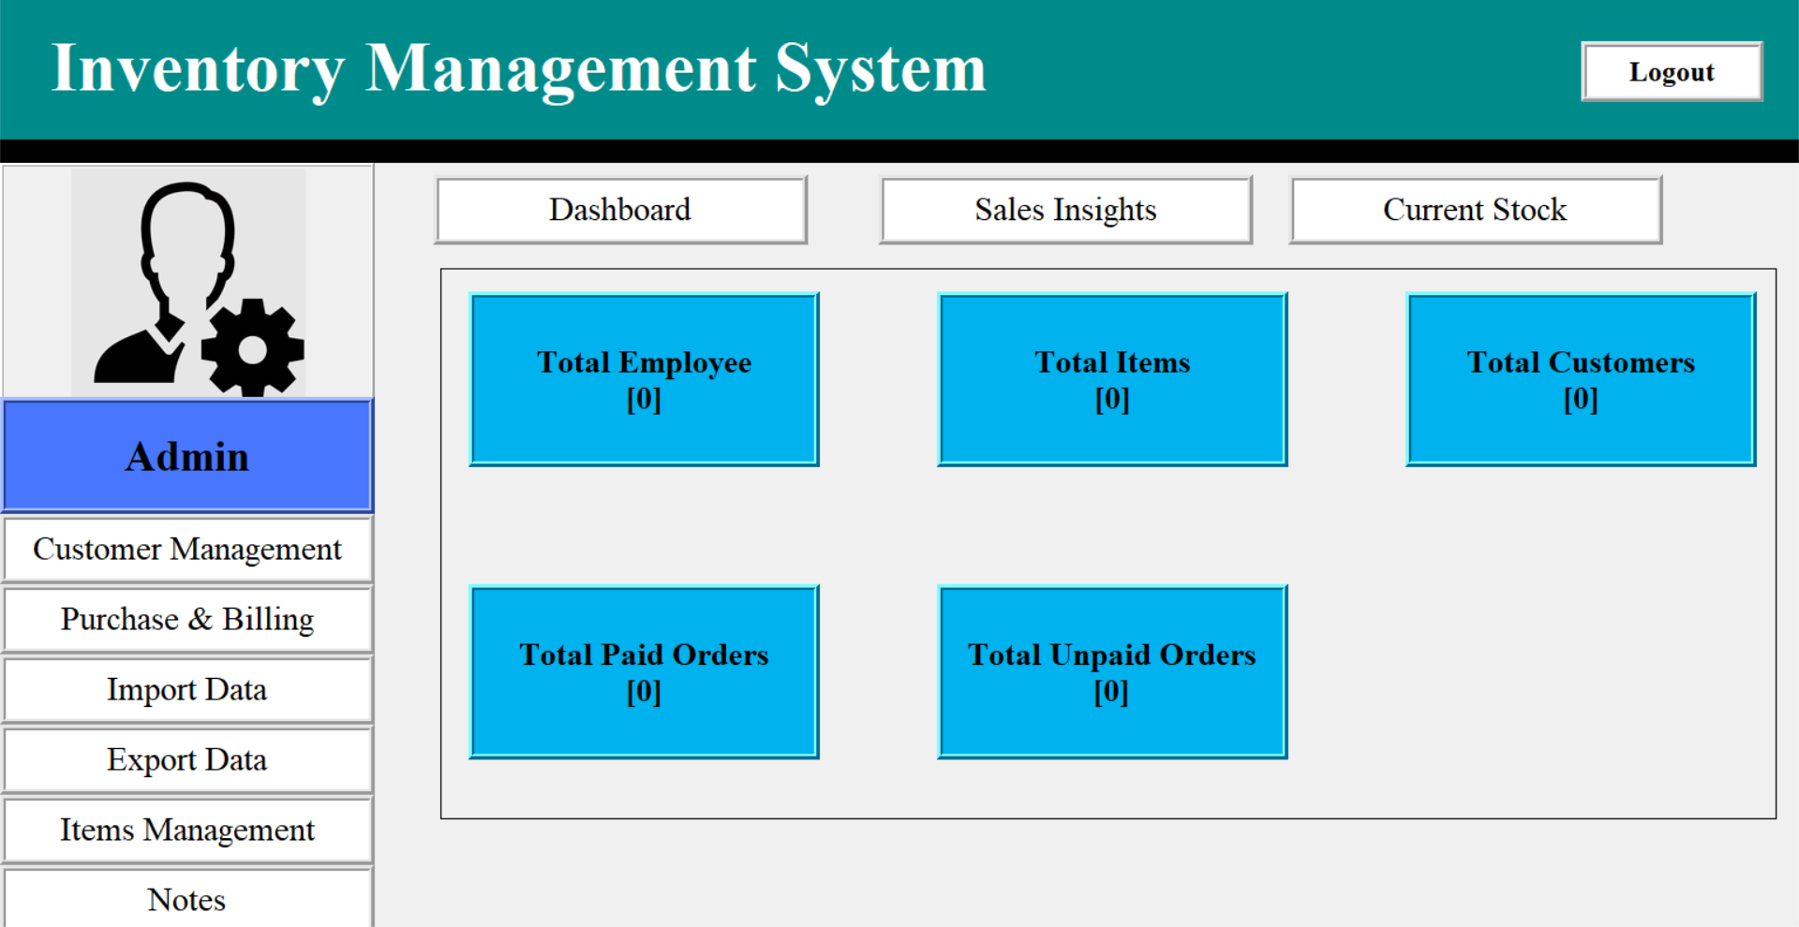

Slide 6
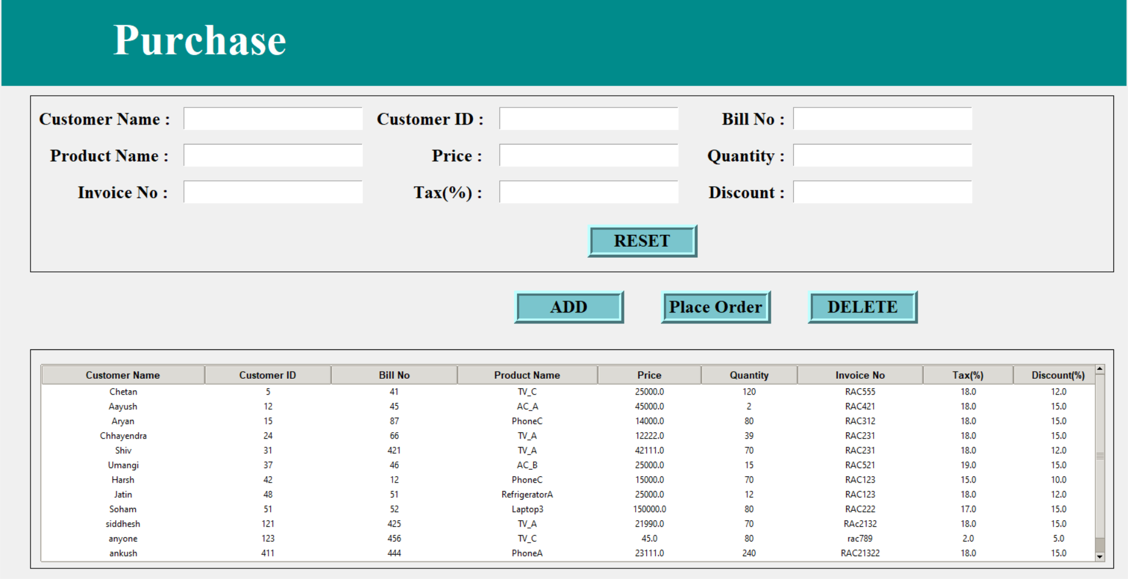

Slide 7
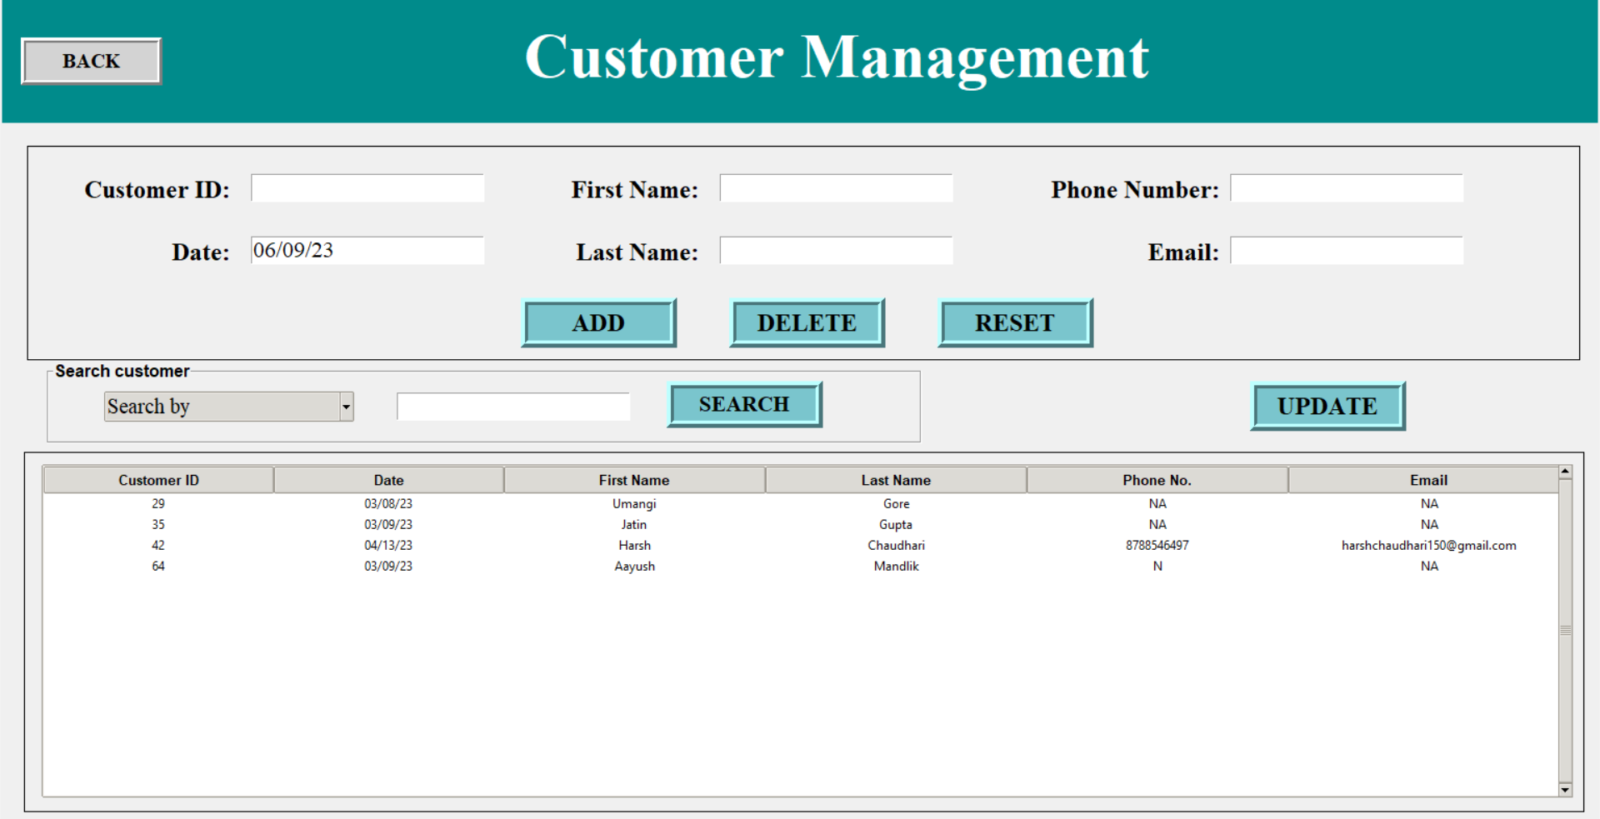

Slide 8
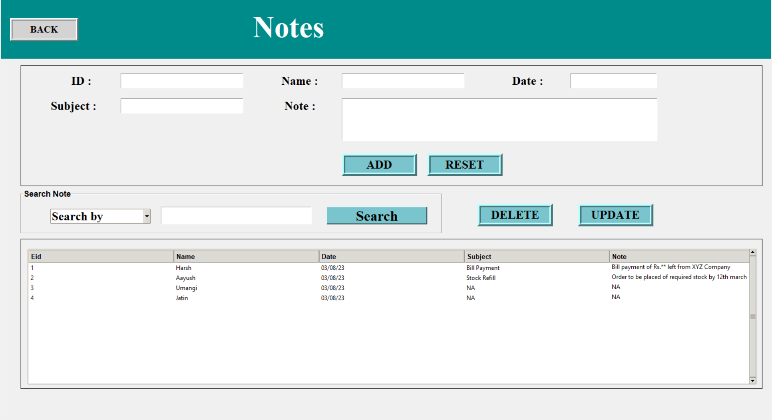

Slide 9
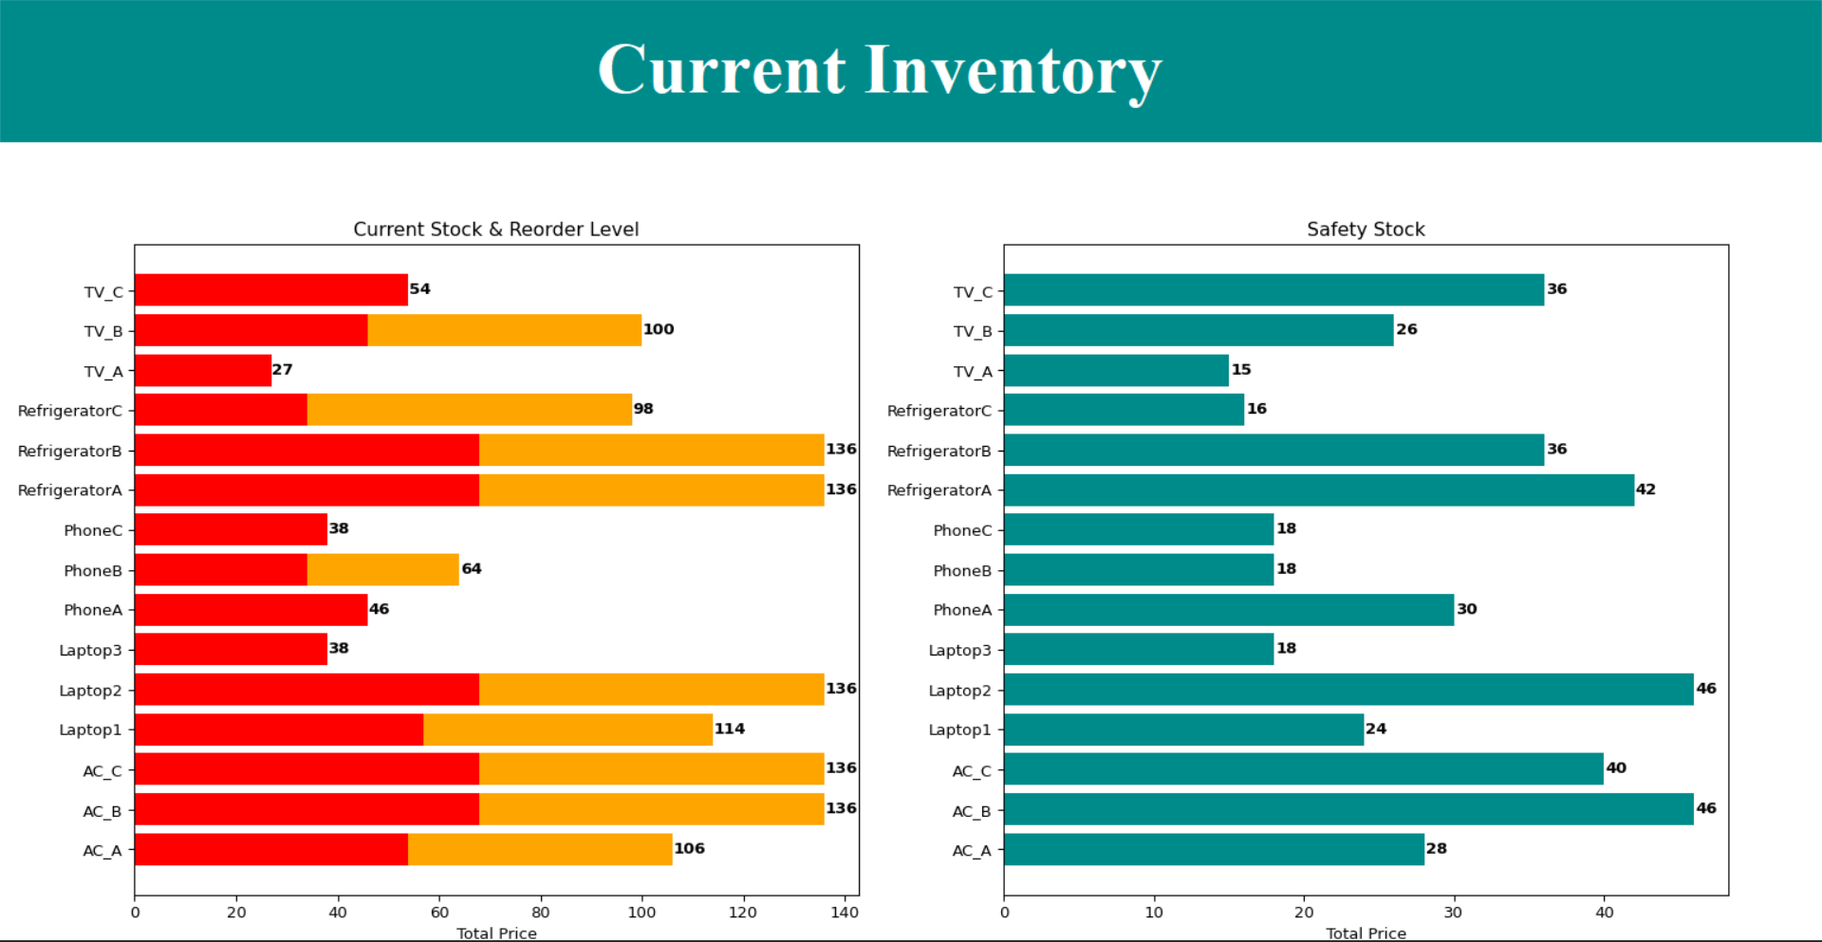

Slide 10
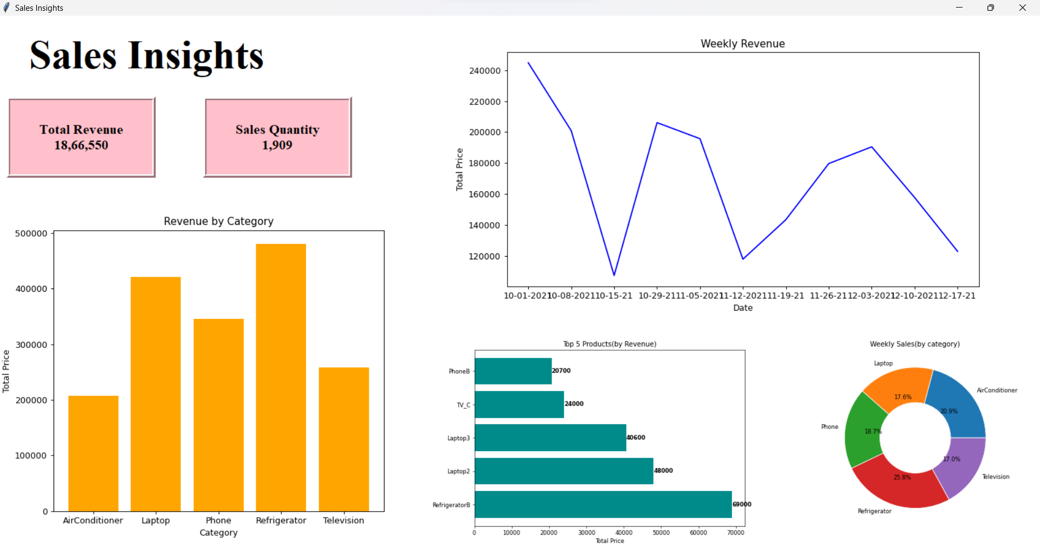

Slide 11
Thank you !!

